Slide 1
Power BI
beginners free 10 weeks online training course

Slide 2
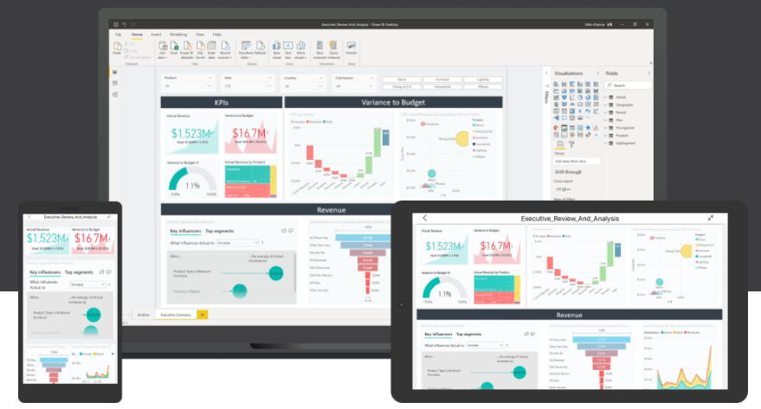

Power BI
beginners free 10 weeks online training course

Slide 3
Power BI Week 1
Monday 18th Jan 2021
Introduction to Power BI and your first Power BI report.
Hi & Intros: David, Conrad
Logistics: Classroom course
Recording on Youtube. Leave if not happy to be recorded
Each week sign up on Meetup.com for the weekly event & Q&A workshop
Each session will be a new Zoom link
Questions into the chat or raise your hand
2 screens is better than 1.
Microphones on mute

Slide 4







David Moss
Azure | Power Platform | D365 Solutions Architect
Delivering end to end Azure AI & BI hybrid solutions with a passion for D365, Power Platform & Power BI reports across IoT, e-commerce, telcos, fintech & manufacturing verticals.
MVP Data Platform
Since 2017 awarded MVP - Microsoft Valued Professional - for my community contributions.
Leader of Power BI meetup user groups in London and online.
Community & conference presenter.
ACMA, CGMA Accountant
@wottabyte
A qualified ACMA accountant all my career which keeps me commercially aware & business facing partner on D365 F&O projects.
wottabyte
www.wottabyte.com
Notes:
Hand out cards & stickers

Slide 5


Conrad Moss : Power BI Developer
Certified MCSA BI Reporting : Power BI & Excel
Power BI Certification 70-778 preparing to take DA-100
Manchester United fan

Slide 6

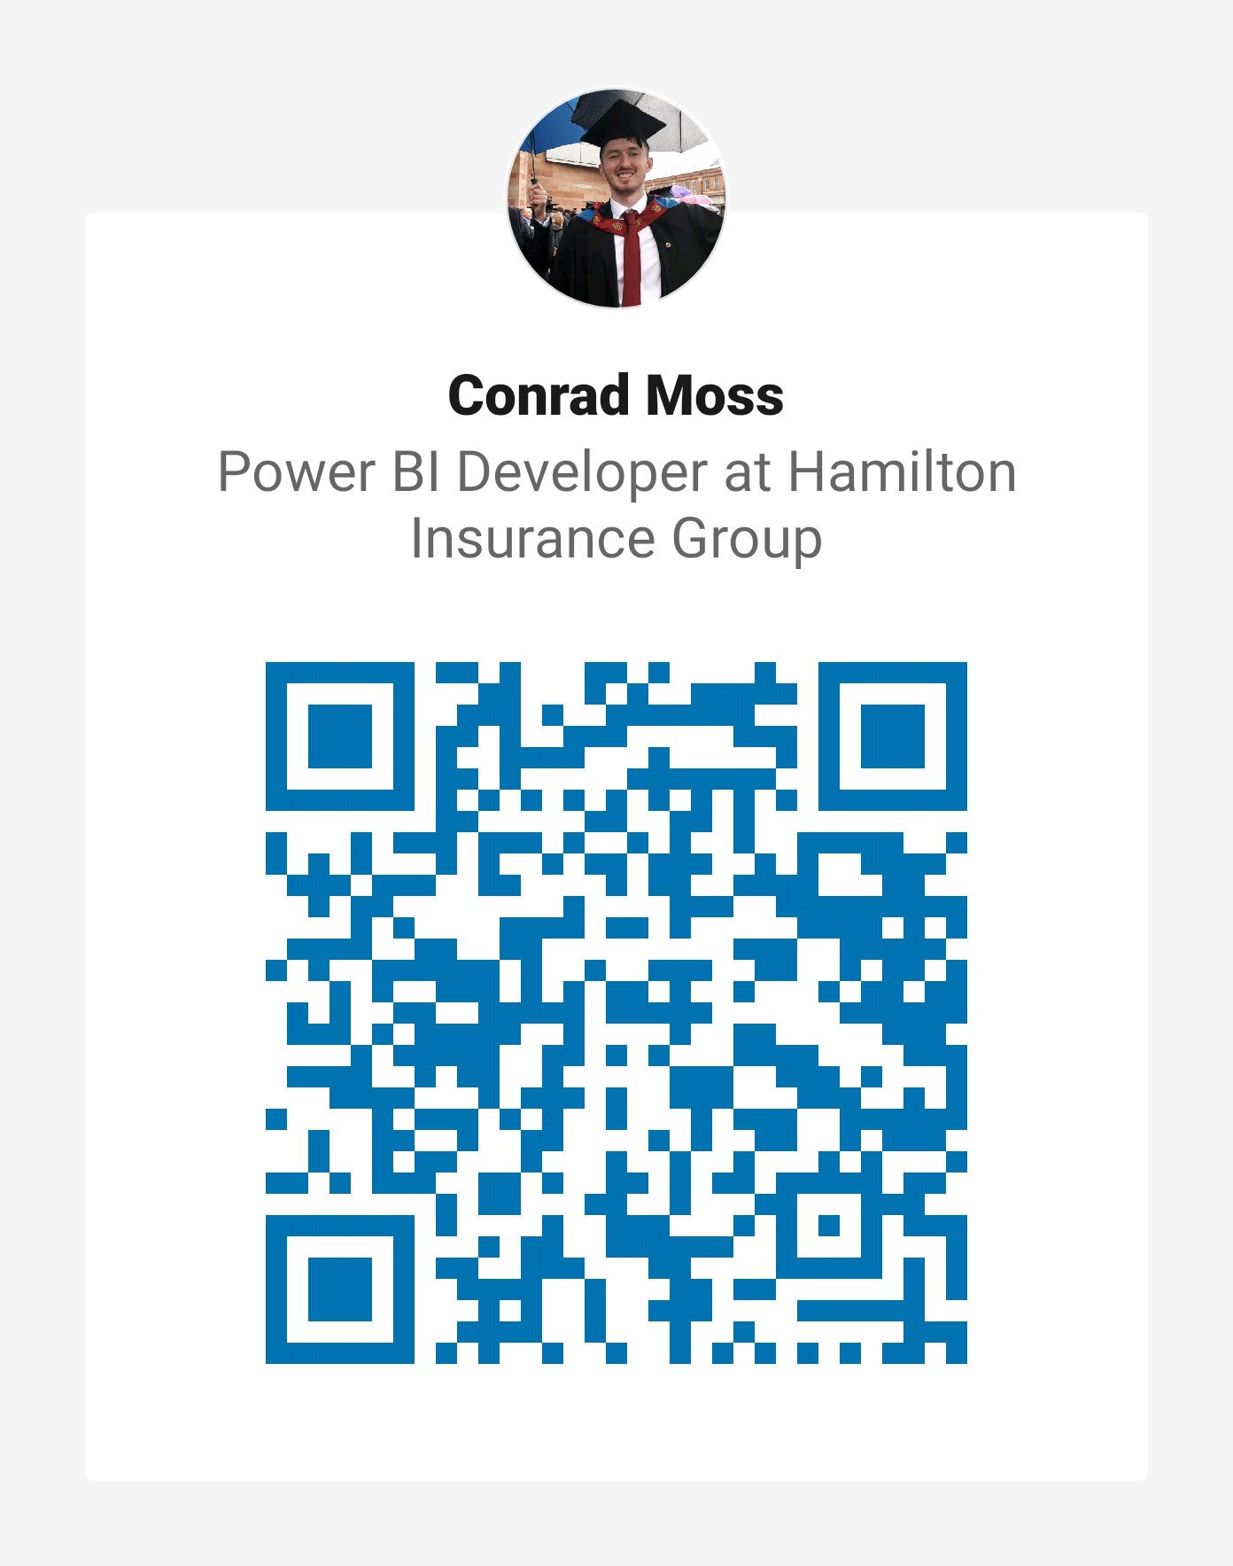
Linkedin : QR Codes

Slide 7
Power BI
beginners free 10 weeks online training course
Week 1: Monday 18th Jan 2021 : Introduction to Power BI and your first Power BI report.
Week 2: Monday 25th Jan 2021 : Use Power Query Editor to get data & prepare your data.
Week 3: Monday 1st Feb 2021 : Use Power BI desktop to structure & create datamodels.
Week 4: Monday 8th Feb 2021 : Design & configure Power BI visuals like charts, maps & KPIs.
Week 5: Monday 15th Feb 2021 : Add user friendly report navigation features, slicers & tooltips.
Week 6: Monday 22nd Feb 2021: Publish & share Power BI reports & dashboards.
Week 7: Monday 1st March 2021: Get to grips with Power BI cloud service & mobile features.
Week 8: Monday 8th March 2021: Enhance your data with DAX for KPIs reporting.
Week 9: Monday 15th March 2021: Data analytics reporting & AI features in Power BI.
Week 10: Monday 22nd March 2021: Power BI at work with workspaces, datasets & security.

Slide 8
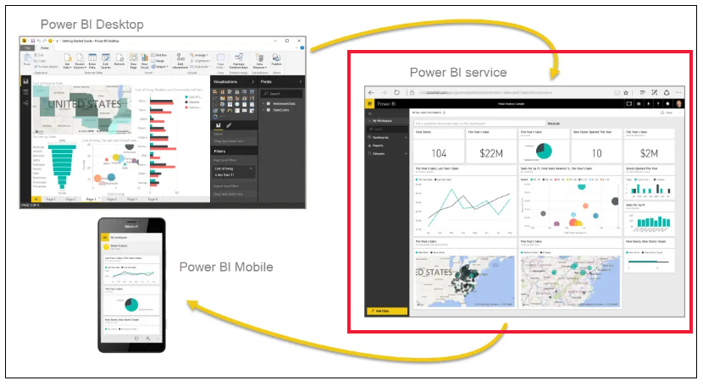
What is Power BI ?

Slide 9
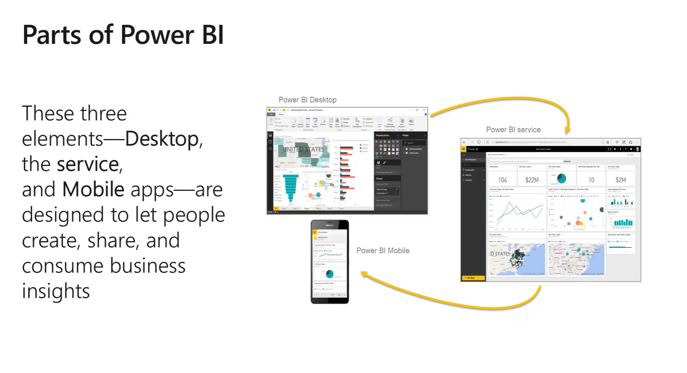
PBI Desktop, PBI Service, PBI Mobile apps

Slide 10
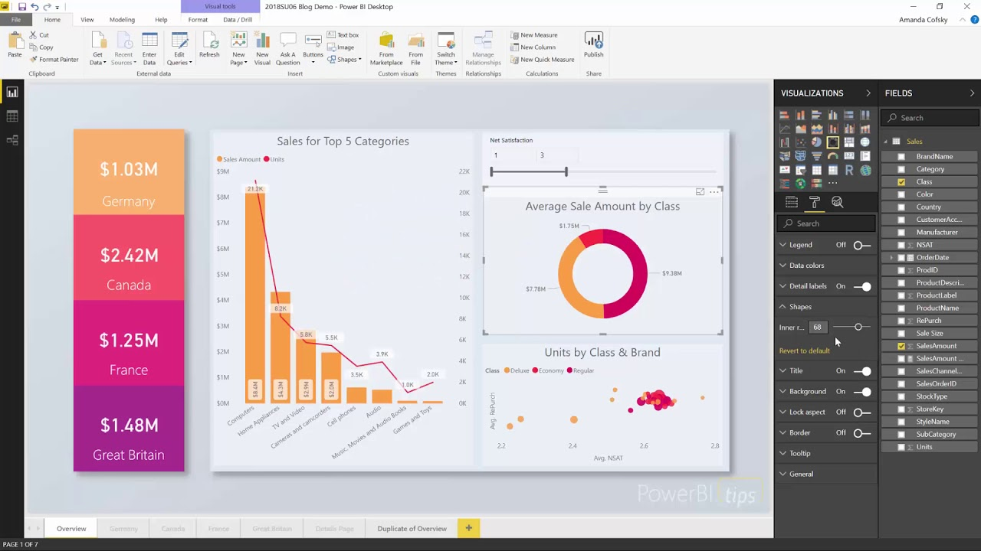
Notes:
Power BI Desktop … Installed ?

Slide 11
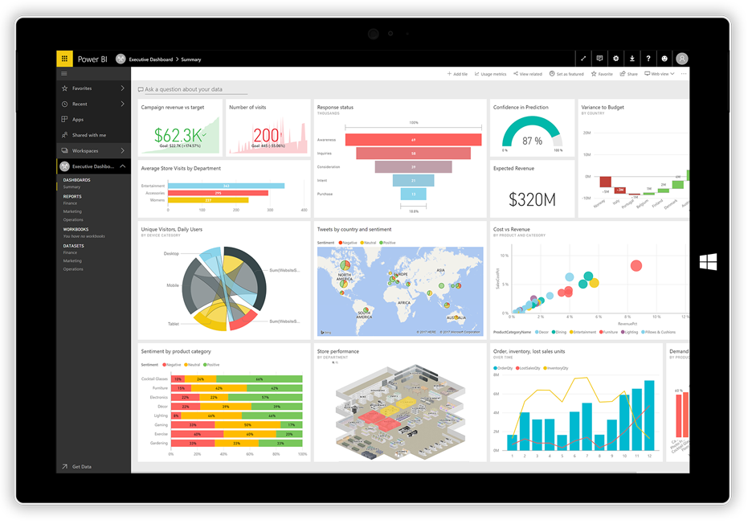
Notes:
Power BI Dashboard

Slide 12

Quick Survey of audience
https://forms.office.com/Pages/ResponsePage.aspx?id=WkuituyrDEaGarPmYT9Z1NvMNOjKOFdHsnEJjP6WpoNUREdYRjdPUUQ0SzlQVzYzUEdJSkVKV1U5Ni4u
Student go to form and submit
Trainer display live online results in Power BI dashboard

Slide 13
Power BI Desktop
Download Power BI Desktop from www.powerbi.com
Install
Build your first report - use blog next page
Quick look at PBI Desktop features
Save your report as .pbix
Get a Microsoft account
Publish to Power BI Service app.powerbi.com
Workshop this eve at 21:00 – 22:00 for 1-2-1 help.

Slide 14
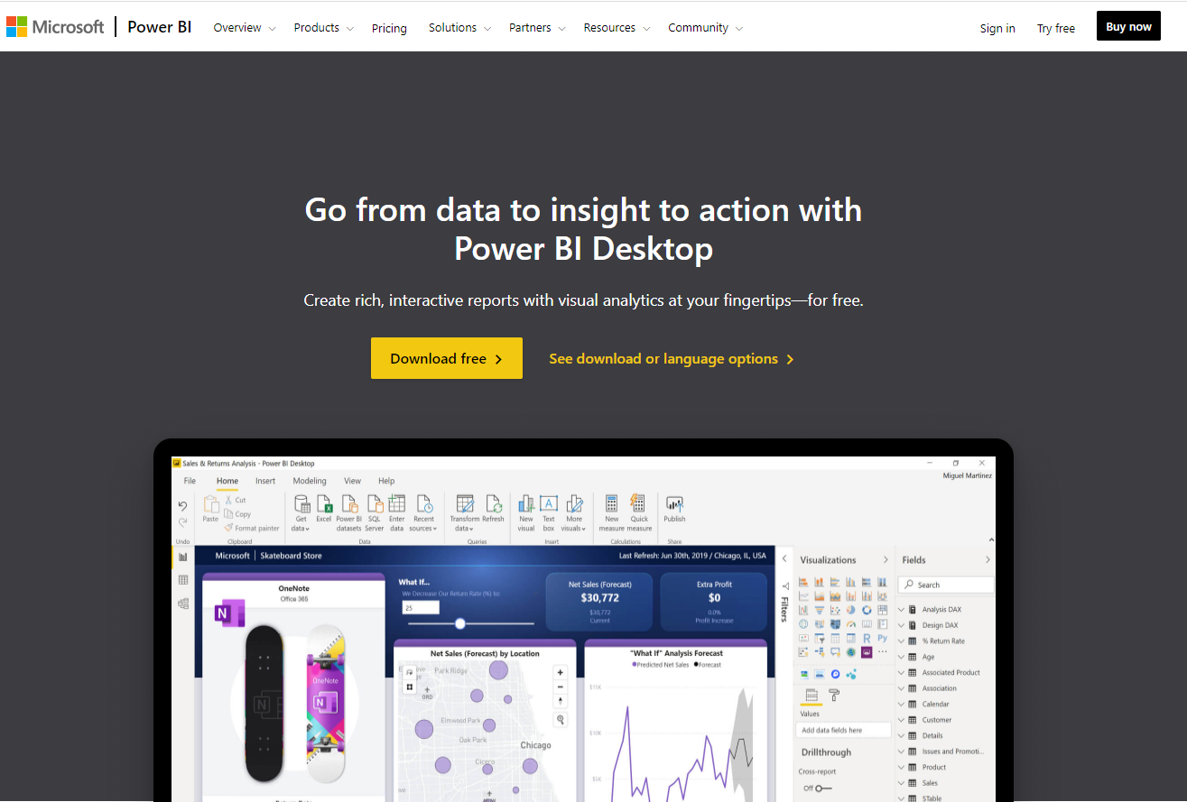
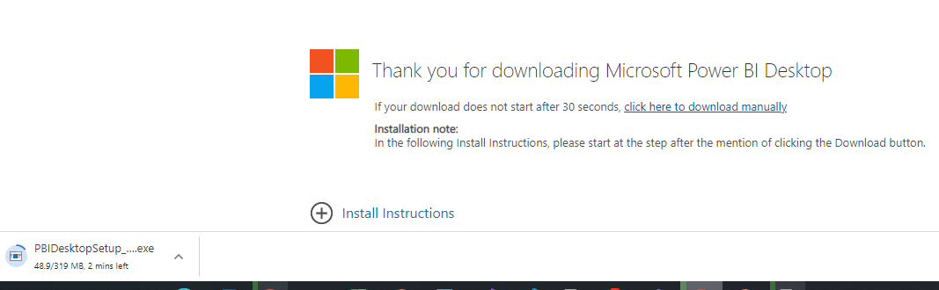
Power BI Desktop
Download Power BI Desktop
Windows Store - W10 app
Or Download desktop version
32 bit or 64 bit
Windows not Apple
What is PBI desktop ?
https://docs.microsoft.com/en-us/power-bi/fundamentals/desktop-getting-started

Slide 15
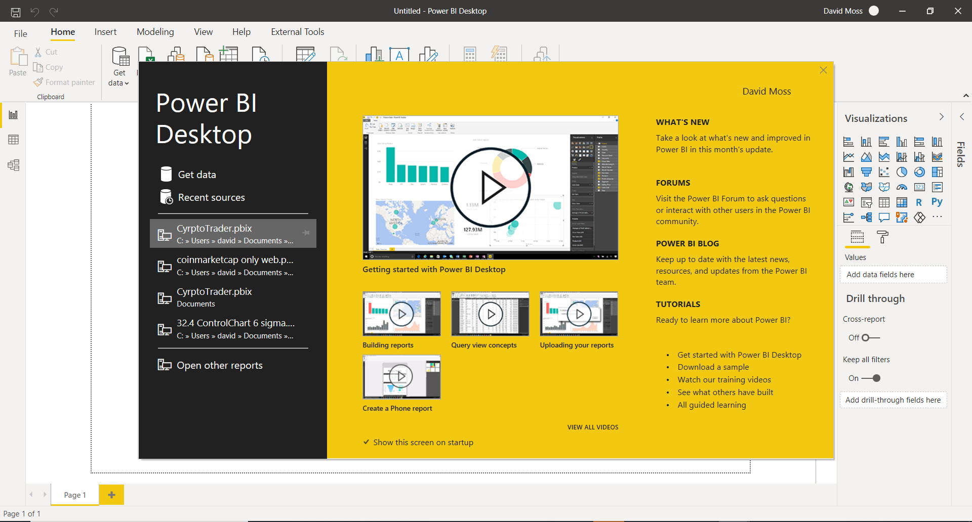

Slide 16
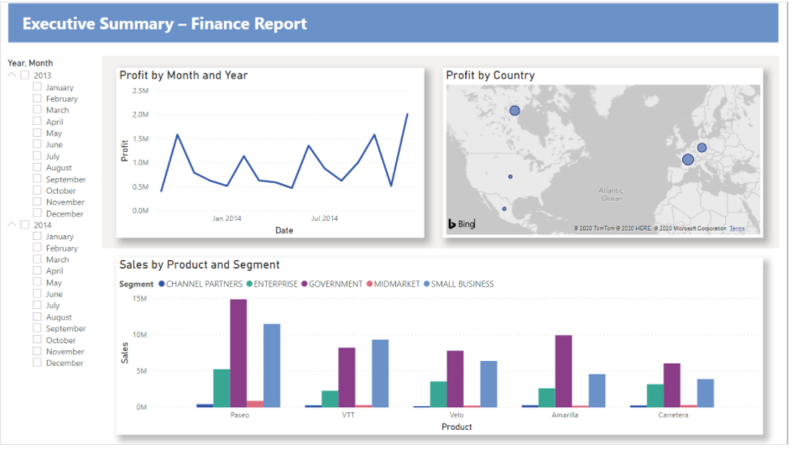
Lesson 1 - build your first report
https://docs.microsoft.com/en-us/power-bi/create-reports/desktop-excel-stunning-report

Slide 17
Publish to www.powerbi.com
Sign in at www.powerbi.com
You need a MS a/c not gmail !!
https://docs.microsoft.com/en-us/power-bi/fundamentals/service-self-service-signup-for-power-bi

Slide 18

Workshop this eve at 21:00 – 22:00 GMT
Q&A Workshop - Power BI Beginner Training Lesson 1
https://www.meetup.com/The-Power-BI-Apprentice/events/275805195/

Slide 19
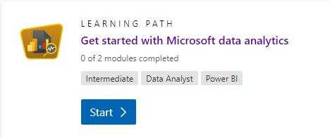
Preparation for next week
Microsoft Learn : https://docs.microsoft.com/en-us/learn/certifications/exams/da-100
Get started with MS data analytics https://docs.microsoft.com/en-us/learn/paths/data-analytics-microsoft/
Microsoft documentation : https://docs.microsoft.com/en-us/power-bi/learning-catalog/

Slide 20
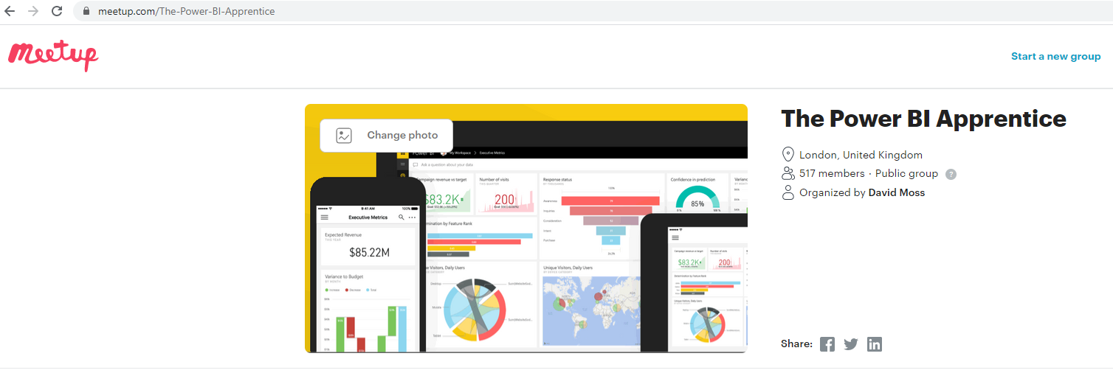
Social Media : Meetup , LinkedIN, YouTube

Slide 21

You Tube
https://www.youtube.com/channel/UCDtmmwK3YxWqzDNZ5L3pdMw

Slide 22

The End

Slide 23
















Slide 24
Power BI – LESSON 2 of 10
beginners free 10 weeks online training course

Slide 25
Power BI Week 2
Monday 25th Jan 2021
Use Power Query Editor to get data & prepare your data
Hi & Intros: David & Conrad
Logistics: Classroom course
Recording on Youtube. Leave if not happy to be recorded
Each week sign up on Meetup.com for the weekly event & Q&A workshop
Each session will be a new Zoom link
Questions into the chat or raise your hand
2 screens is better than 1.
Microphones on mute
Workshop at 21:00 : register now at https://www.meetup.com/The-Power-BI-Apprentice/events/

Slide 26
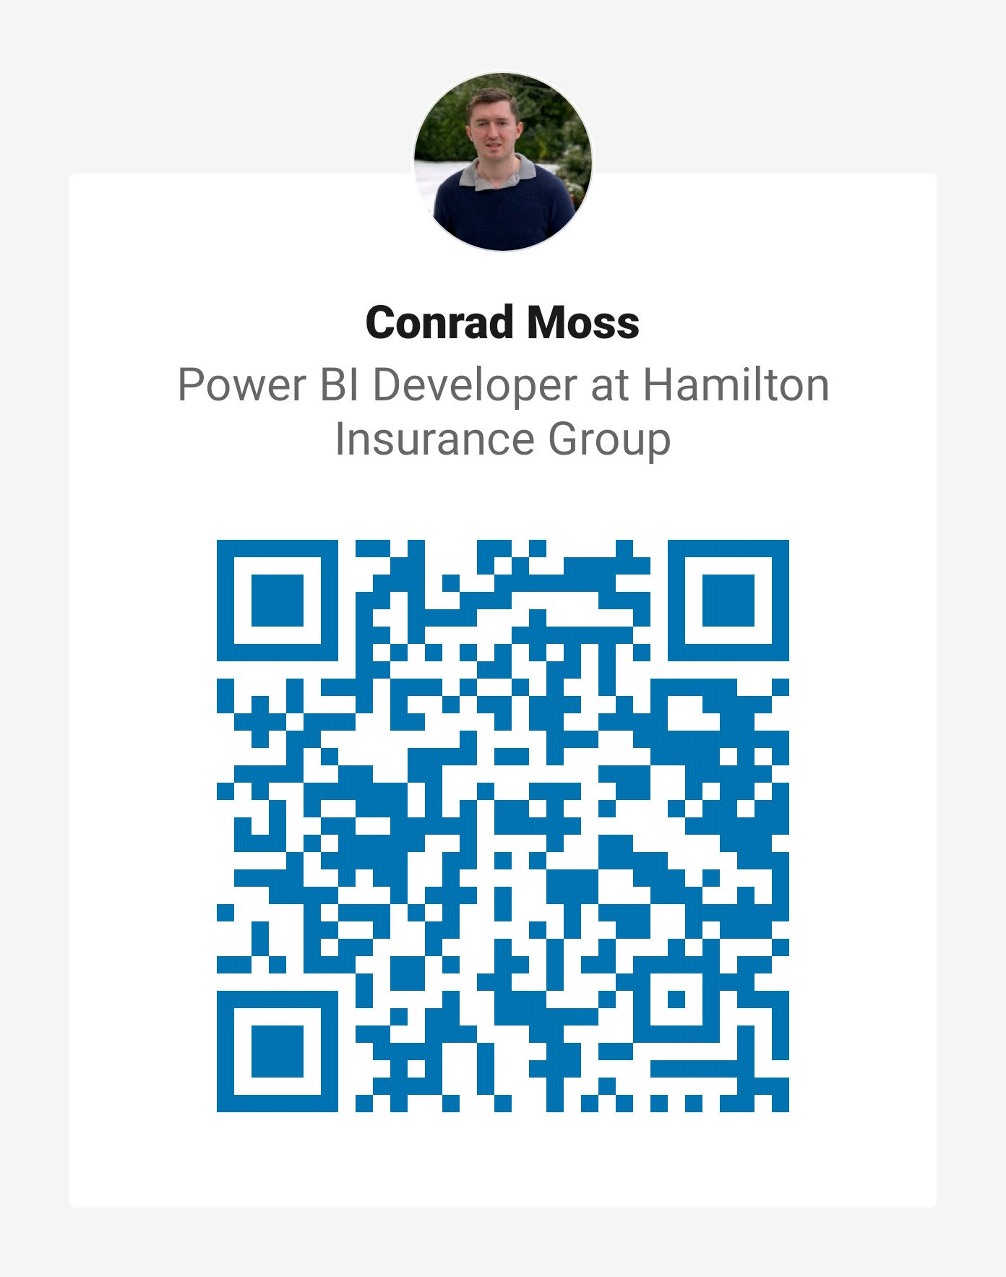
Linkedin : QR Codes

Slide 27
Power BI
beginners free 10 weeks online training course
Week 1: Monday 18th Jan 2021 : Introduction to Power BI and your first Power BI report.
Week 2: Monday 25th Jan 2021 : Use Power Query Editor to get data & prepare your data.
Week 3: Monday 1st Feb 2021 : Use Power BI desktop to structure & create datamodels.
Week 4: Monday 8th Feb 2021 : Design & configure Power BI visuals like charts, maps & KPIs.
Week 5: Monday 15th Feb 2021 : Add user friendly report navigation features, slicers & tooltips.
Week 6: Monday 22nd Feb 2021: Publish & share Power BI reports & dashboards.
Week 7: Monday 1st March 2021: Get to grips with Power BI cloud service & mobile features.
Week 8: Monday 8th March 2021: Enhance your data with DAX for KPIs reporting.
Week 9: Monday 15th March 2021: Data analytics reporting & AI features in Power BI.
Week 10: Monday 22nd March 2021: Power BI at work with workspaces, datasets & security.

Slide 28

Power BI Week 2
Monday 25th Jan 2021
1st a quick QUIZ !! www.mentimeter.com
50 24 12 1
https://www.menti.com/csb5wsjst2

Slide 29
Power BI Week 2
Monday 25th Jan 2021
1st lets finish of Lesson 1
Complete Power BI report from Lesson 1
Sign up & login for Power BI Service account (needs a Microsoft a/c)
Publish report to the Power BI service
Explain what is Power BI Service basics
Navigate report in Power BI Service
Back to get & prepare data with Power Query Editor

Slide 30
Complete Power BI report from Lesson 1
Open blog https://docs.microsoft.com/en-us/power-bi/create-reports/desktop-excel-stunning-report
Demo a step
Show finished report
Save Power BI desktop report as .pbix locally
Conrad demo

Slide 31
What is Power BI ?

Slide 32
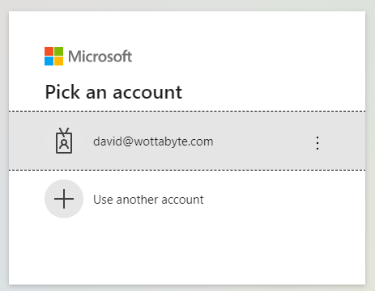

Create a Power BI Service account
Sign up & login with Power BI account (needs a Microsoft a/c)
Goto www.powerbi.com and click ‘Sign in’. Free license.
Work or school a/c ? If none then create a Microsoft a/c but cannot use a gmail. https://docs.microsoft.com/en-us/power-bi/consumer/end-user-sign-in
If fails we can help you during the workshop later this eve.
Show Power BI Service Home page My workspace is blank.
Help @ Workshop if needed or read https://docs.microsoft.com/en-us/power-bi/fundamentals/service-self-service-signup-for-power-bi

Slide 33

Workshop this eve at 21:00 – 22:00 GMT
Monday 25th Jan 2021
Q&A Workshop - Power BI Beginner Training Lesson 2 of 10
https://www.meetup.com/The-Power-BI-Apprentice/events/275871416/

Slide 34
Quick Survey of audience
https://forms.office.com/Pages/ResponsePage.aspx?id=WkuituyrDEaGarPmYT9Z1NvMNOjKOFdHsnEJjP6WpoNUREdYRjdPUUQ0SzlQVzYzUEdJSkVKV1U5Ni4u
Student go to form and submit
Trainer display live online results in Power BI dashboard

Slide 35


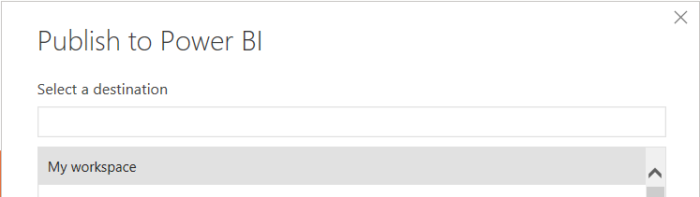
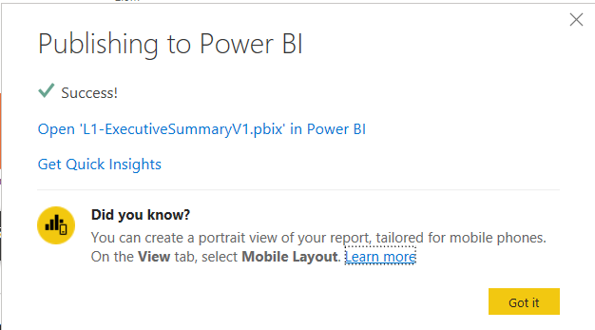
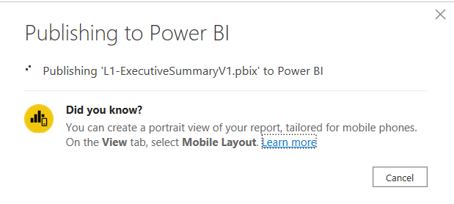
Publish to Power BI
.pbix report
Back in Power BI Desktop
open .pbix then Click Publish
Select My Workspace and click confirm.
Check success message
Goto www.powerbi.com
Open My Workspace
See you report
Navigate report

Slide 36
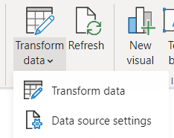
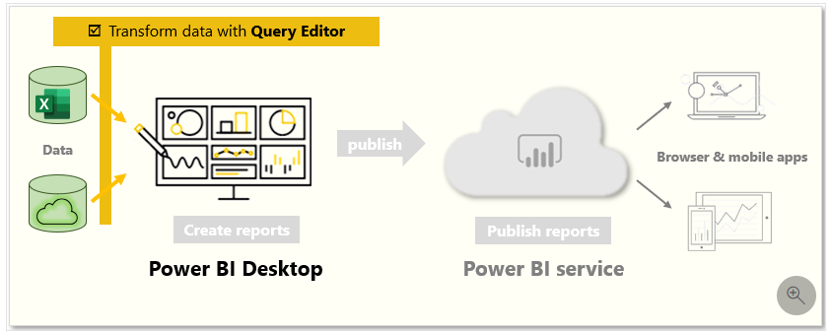
Power BI Week 2
Monday 25th Jan 2021
Use Power Query Editor to get data & prepare your data
Back to get & prepare data with Power Query Editor
From Power BI Desktop open Power Query Editor...how ?
Show PQE features
Power Query Language = M
BTW it’s the same in Excel
Get data & transform as demo in Learn

Slide 37
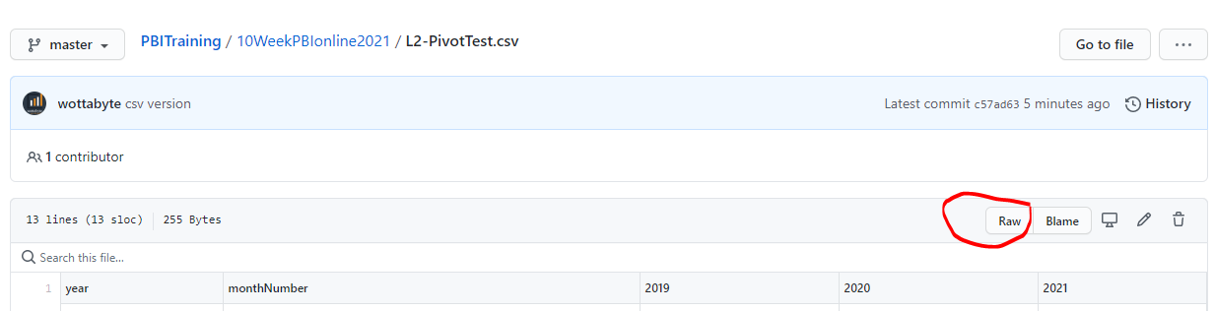
Power BI Week 2
Power Query Editor: Capitalize & UNpivot data demo
Csv > raw ? See url : https://github.com/wottabyte/PBITraining/tree/master/10WeekPBIonline2021
PQE use Web
Lowercase then capitalize
Pivot years
Close & Apply

Slide 38
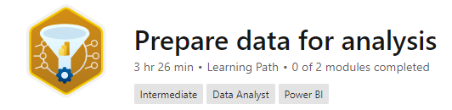
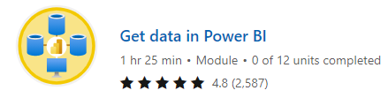
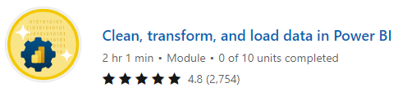
Power BI Week 2 CourseWork
Monday 25th Jan 2021
Microsoft Learn - Complete Learning Path ‘Prepare Data for analysis’
Module – ‘Get data in Power BI
Module – ‘Clean, transform and load data in Power BI
Download the slides from GitHub
https://docs.microsoft.com/en-us/learn/paths/prepare-data-power-bi/

Slide 39
Social Media : Meetup , LinkedIN, YouTube
@wottabyte
wottabyte
www.wottabyte.com

Slide 40
You Tube
https://www.youtube.com/channel/UCDtmmwK3YxWqzDNZ5L3pdMw

Slide 41
Power BI Week 3
1st February
Use Power BI desktop to structure & create datamodels
Watch your email & social media channels for when event goes live for registration.

Slide 42
The End

Slide 43
Power BI Week 2
Template
Text & Visuals

